Slide 1

Equation to Animation: Crafting Dynamic Math Visuals on the Web
Slides
https://bit.ly/codemash2025-math-precompiler

Slide 2


Courtney Yatteau
Developer Advocate at Esri
@c_yatteau
courtneyyatteau
@cyatteau.bsky.social

Slide 3
Workshop Goals
Understand data visualization basics
Master key libraries
Build interactive visuals
Integrate geospatial elements
Apply concepts in real projects

Slide 4
Agenda
Introduction
2. Tools & Setup
3. Chart.js
4. D3.js
5. Wrap-Up
Goals & value of data visualization.
Overview of D3.js, Chart.js, and environment setup.
Building basic charts and graphs.
Creating customizable and unique charts and graphs.
Key takeaways and Q&A.

Slide 5
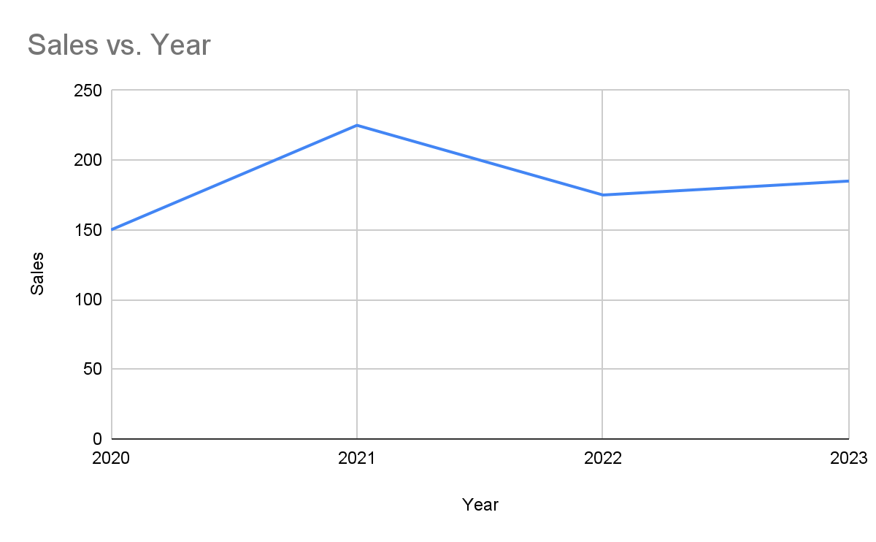
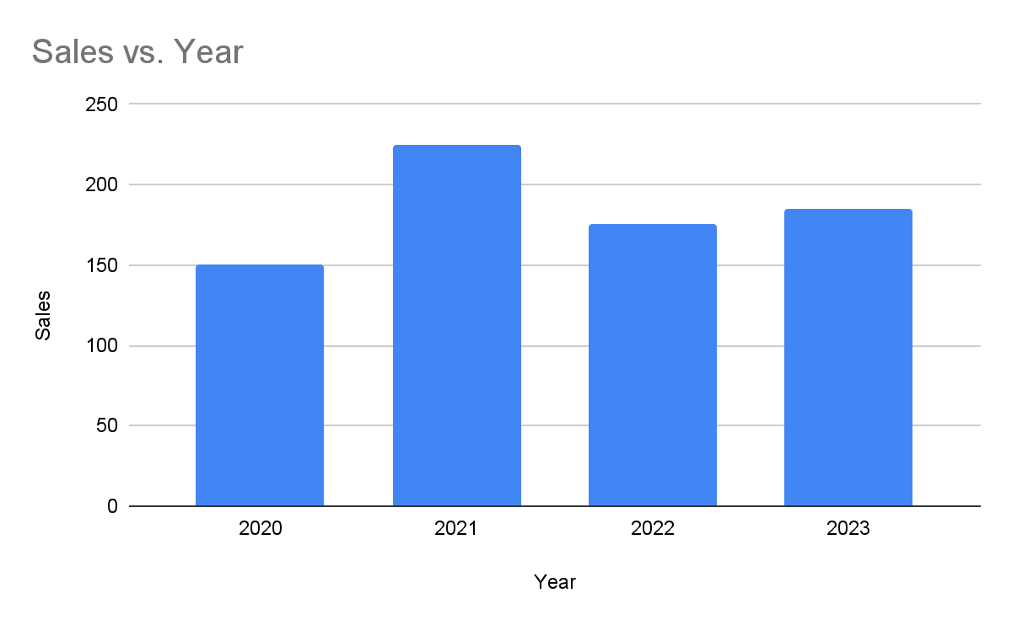
Why Data Visualization?
Year | 2020 | 2021 | 2022 | 2023
Sales | 150 | 225 | 175 | 185
Notes:
Makes complex data understandable.
Engages and educates users.
Essential for math, education, and analysis.
When we think about data visualization, it’s not just about making things look pretty—it’s about transforming raw, complex data into meaningful insights. Let me show you a few examples that highlight this.

Slide 6
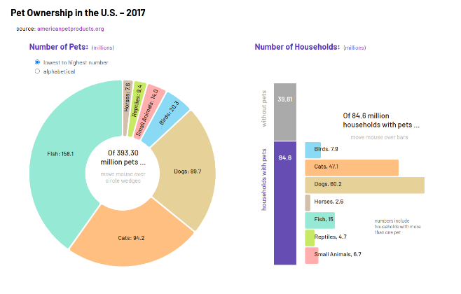
Interactivity
Notes:
"Static charts are informative, but interactivity takes data visualization to the next level."
"Interactive elements engage users, help them explore data more deeply, and reveal patterns they might otherwise miss."
"Today, we'll explore how to add interactivity to visualizations using libraries like Chart.js and D3.js."
"You’ll see how adding even simple interactions, like tooltips or click events, can make your visualizations more engaging."

Slide 7
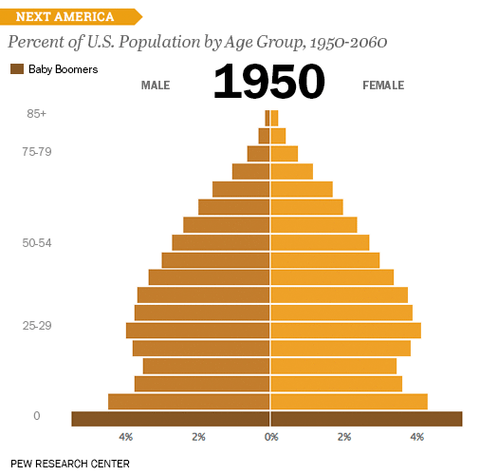
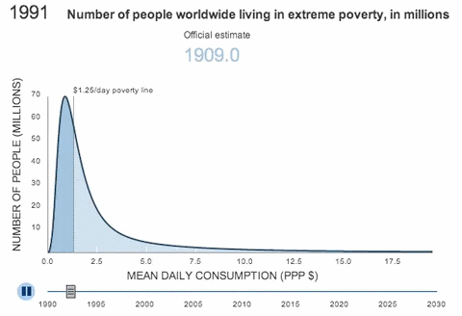
Real-World Examples
Notes:
"Data visualization is used across industries—education, marketing, urban planning, healthcare, and more."
The Dwindling of Extreme Poverty The U.S. Age Pyramid
"These examples show how effective visualization can be in telling a story or making data relatable."

Slide 8






Tools & Setup
Visual Studio Code
Install here.
VS Code Extensions
Live Server - install here
Prettier - install here
CDN Links for JS Libraries
<script src="https://cdn.jsdelivr.net/npm/chart.js"></script>
<script src="https://cdn.jsdelivr.net/npm/d3@7.9.0/dist/d3.min.js"></script>
Workshop Modules Site
Sign up here

Slide 9
Visual Studio Code Setup
Stepup: HTML file shortcut (! + Enter)
Test out Extensions
Prettier
Live Server

Slide 10
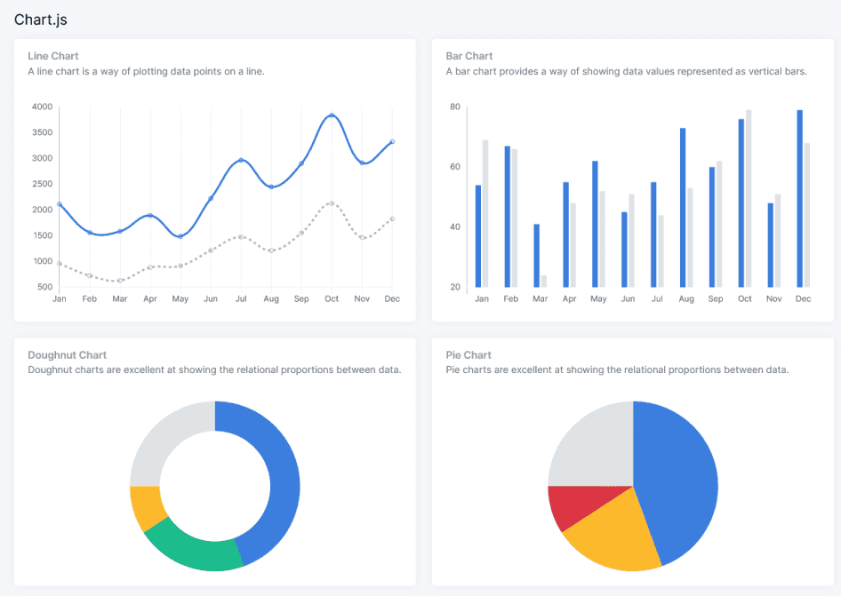
What is Chart.js
Chart.js: A simple, easy-to-use JS library for interactive charts.
Supported Chart Types: Area, Bar, Bubble, Doughnut and Pie, Line, Polar Area, Radar, Scatter.
Why Chart.js?: Lightweight, beginner-friendly, great for basic charts with some interactive features.
Notes:
Introduction to Chart.js:
Chart.js is a simple, easy-to-use JavaScript library designed for creating interactive charts.
Chart Types Supported:
Bar
Line
Pie
Radar
Scatterplot
And more...
Usage Example:
Integrates easily into web pages with just a few lines of code.
Can be combined with interactive features like tooltips, animations, and hover effects.
Why Choose Chart.js?
Lightweight: Ideal for small to medium-sized projects.
Beginner-friendly: Great for those new to data visualization.
Great for basic charts: Provides quick, interactive results with minimal setup.

Slide 11
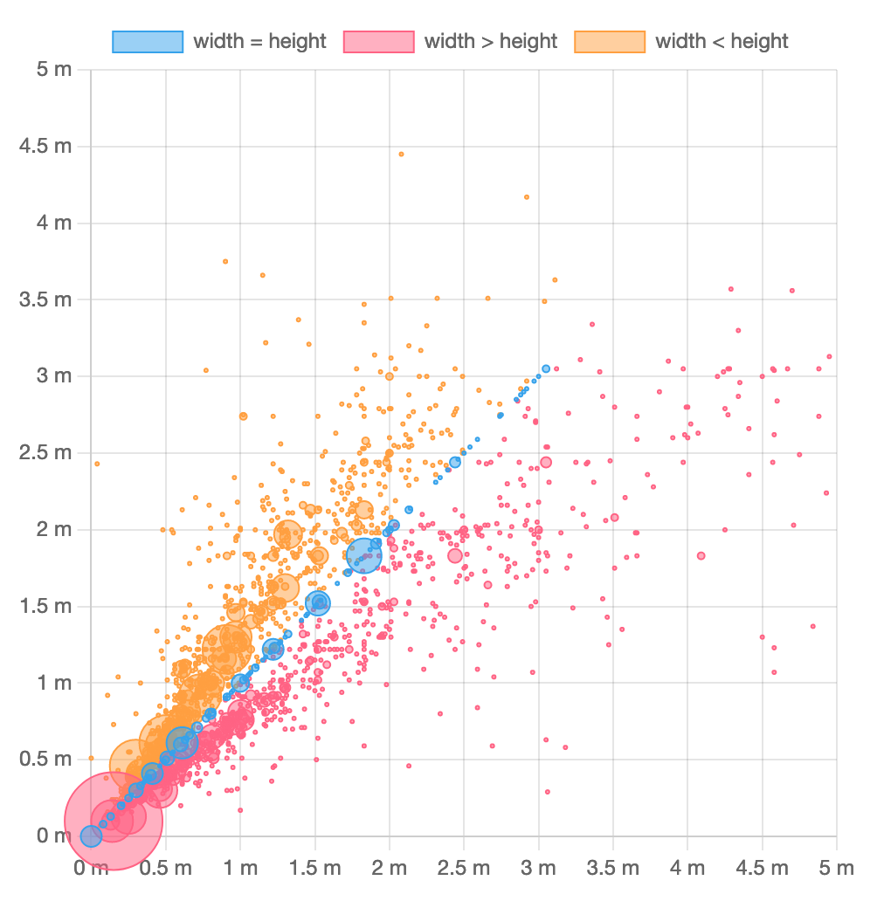
Chart.js - Rendering
Canvas Rendering: Renders charts on an HTML5 canvas.
Performance: Ideal for large datasets (no DOM nodes to manage).
Limitation: No CSS styling—customization through built-in options or custom plugins.
Notes:
Canvas Rendering:
Chart.js uses HTML5 canvas rendering for chart elements.
Unlike SVG-based libraries (like D3.js), canvas is pixel-based and renders directly to the screen.
Performance Benefits:
Canvas rendering makes Chart.js highly performant, especially for large datasets and complex visualizations.
No DOM Nodes: Unlike SVG, canvas doesn’t require managing thousands of DOM elements, which can slow down the rendering process.
Ideal for visualizations requiring rapid rendering, such as dashboards or real-time data feeds.
Limitation:
CSS Styling Limitation: Canvas rendering doesn’t support CSS styling. Customization needs to be done using Chart.js options or by creating custom plugins or chart types.
CSS features like hover effects and colors must be set using Chart.js built-in configurations.

Slide 12
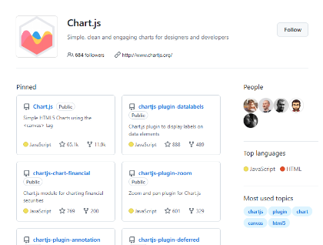
Chart.js - History and Community
Popularity:
GitHub Stars: ~60,000
npm Downloads: ~2.4 million weekly
History: Created in 2013, open-source, MIT license.
Community: Actively maintained by an open-source community with lots of plugins.
Notes:
Popularity and Community:
GitHub Stars: ~60,000 (as of 2025)
npm Downloads: ~2,400,000 weekly (indicating widespread use).
Chart.js is the most popular charting library for JavaScript developers today, thanks to its simplicity and flexibility.
History of Chart.js:
Created in 2013 by Nick Downie and has grown over time.
Initially created to be simple and lightweight, Chart.js has evolved into one of the most widely used charting libraries in the JavaScript ecosystem.
Active Open-Source Community: Chart.js is maintained by a large community of contributors, making it a reliable choice for developers.
License: Open-source and free to use under the MIT license, which allows for flexibility in personal or commercial projects.

Slide 13
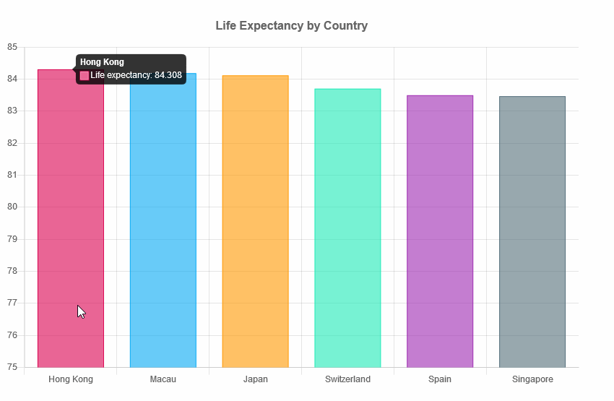
Bar Charts
What is a Bar Chart? A bar chart visualizes comparisons across different categories, where each bar's height indicates its value or frequency.
When to Use Bar Charts: They are perfect for comparing distinct categories and highlighting specific comparisons.
Notes:
Demographic Data: Visualizing demographic information like age groups, income brackets, or educational levels within a population.
Academic Scores: Displaying average test scores or grades for students across different subjects or classes.
Website Traffic: Showing the number of visitors to different sections of a website.

Slide 14
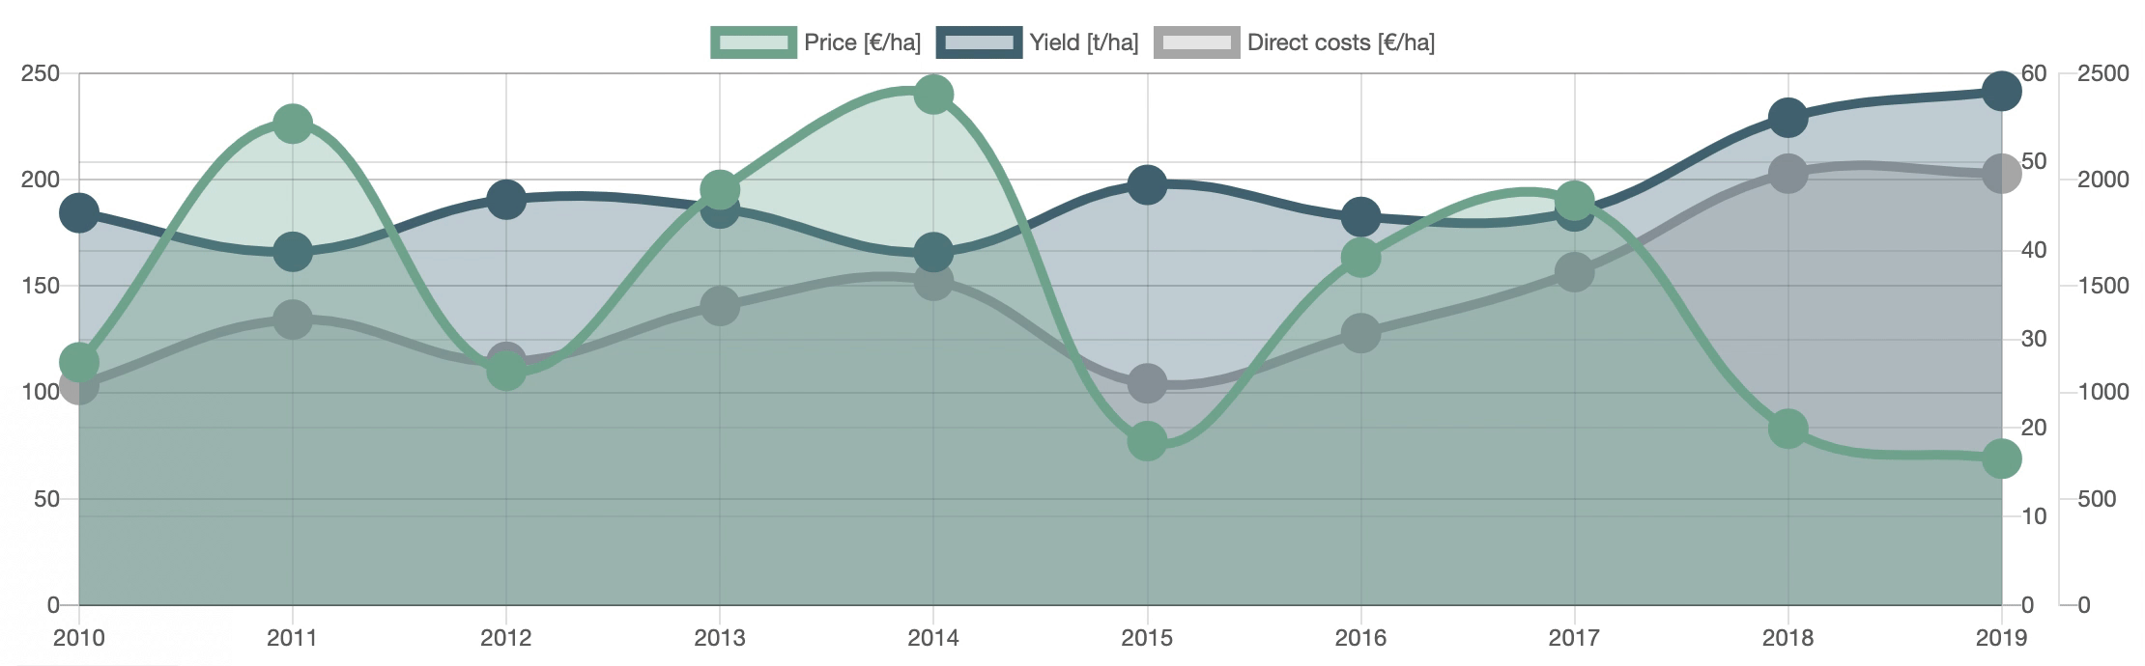
Line Charts
What is a Line Chart?
A line chart displays data points connected by lines.
When to Use Line Charts:
Ideal for visualizing trends and changes over time, especially when comparing data continuously.
Notes:
Tracking Stock Market Trends: Observing the rise and fall of stock prices over a period.
Monitoring Temperature Changes: Displaying daily or seasonal temperature variations.
Website Traffic: Viewing the number of visitors to a website on different days or months.

Slide 15
Complete Modules 1 and 2 on the Workshop Site
Finished early? Explore the Chart.js site or move onto Module 3!

Slide 16
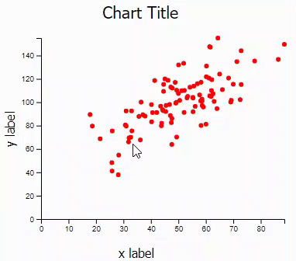
Scatterplot
What is a Scatter Plot?
A scatter plot is used to visualize the relationship between two numeric variables.
Each point represents a pair of values, plotted on the X and Y axes.
When to Use Scatter Plots:
Best for correlation analysis: Shows how two variables are related.
Ideal for visualizing clusters or outliers.
Useful for regression analysis, identifying patterns, or comparing distributions.

Slide 17

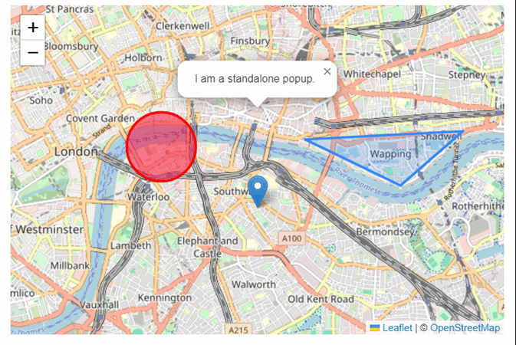
Leaflet
Leaflet: JavaScript library for interactive maps.
Lightweight: Only about 42 KB of JS and it’s easy to integrate with charts.
Use Case: Perfect for embedding maps in web applications.
Note: View is set with an initial latitude and longitude. You can use this geocoding search tool for finding locations. (Replace: ADDRESS/PLACE)
Notes:
https://geocode-api.arcgis.com/arcgis/rest/services/World/GeocodeServer/findAddressCandidates?f=pjson&outFields=*&singleLine=ADDRESS/PLACE&token=AAPTxy8BH1VEsoebNVZXo8HurMKPu3fXOu2arFhBuGC_SGlZ4cMWq2zuwnJUed67b7HzmuUNbwJ3nV0b2nTwsLbjvfG-iVxWYgjJyg2Fkq6pYRLanyEpMJ9qn7950ovy7LqOvvfT2gXa9Z5zWod8eZk555RTiHqNPIQU6W_Zu5JxtRFMF5rW__w4-8dzQd85TVLl9o-rIPJzHvhgH4Rxp_a95wahylZ1S8QDXQOCPup_9jw

Slide 18
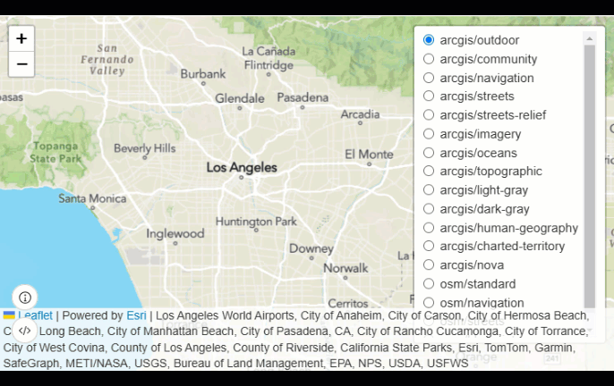
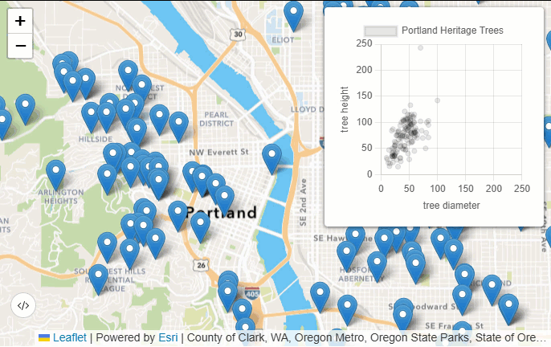
Esri Leaflet
Esri Leaflet: Adds Esri's mapping capabilities to Leaflet.
Features: Access to Esri basemaps, feature layers (e.g. ArcGIS Hub and Living Atlas), and geospatial services.
Combining with Charts: Use map features to dynamically update charts with relevant data.
Notes:
Show off Feature Layers (at ArcGIS Hub and Living Atlas - try searching population) and Esri’s Basemap styles…

Slide 19
Complete Module 3 on the
Workshop Site
Finished early? Explore the Leaflet documentation or move onto Module 4!

Slide 20
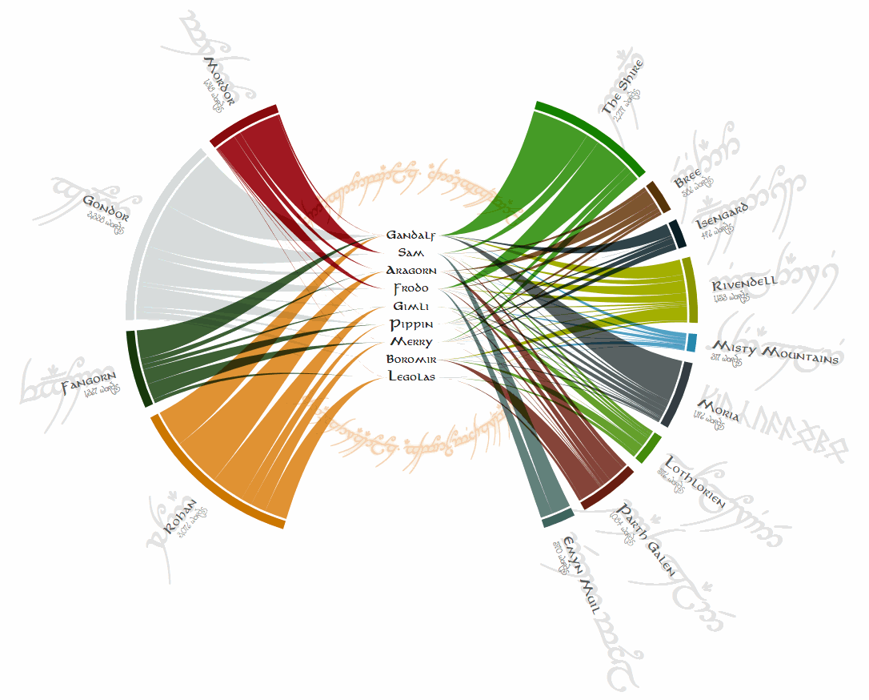
D3.js
D3.js: JS library for creating complex, data-driven visualizations.
Key Feature: Manipulates the DOM based on data.
Why Use D3?: More flexibility and customization than Chart.js.
Notes:
if your data visualization needs go beyond the basics and require a detailed, hands-on approach to design and functionality, D3.js is the tool you'll want to use.
The chart was initially created to explore interactions in "Lord of the Rings" by showing character-location dialogues via the width of connecting strings
This example showcases D3.js's strength in crafting highly customized and interactive visualizations that go beyond the capabilities of Chart.js, particularly for complex datasets involving intricate relationships

Slide 21

D3.js and SVGs
SVGs: Uses Scalable Vector Graphics (SVG) for browser rendering.
Complex Visualizations: Create radial charts, bubble charts, force-directed graphs, and more.
Benefits: Ideal for responsive, interactive, and customizable visuals.
Notes:
D3.js uses SVG, allowing for more complex and interactive visuals than Chart.js's canvas-based rendering,
CSS for customization
Display the duration of Taylor Swift's songs across her albums in a circular layout, enhancing user engagement with tooltips that provide detailed insights into each track.

Slide 22

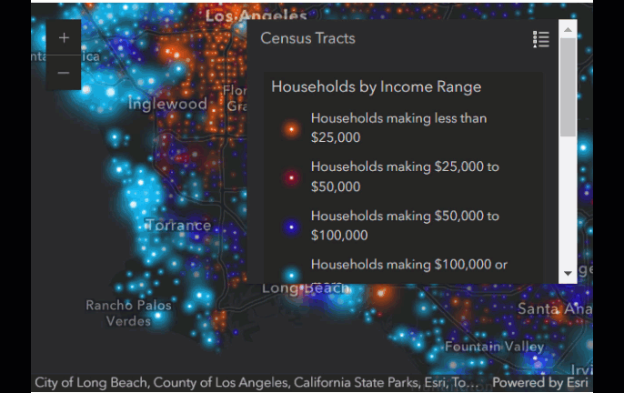
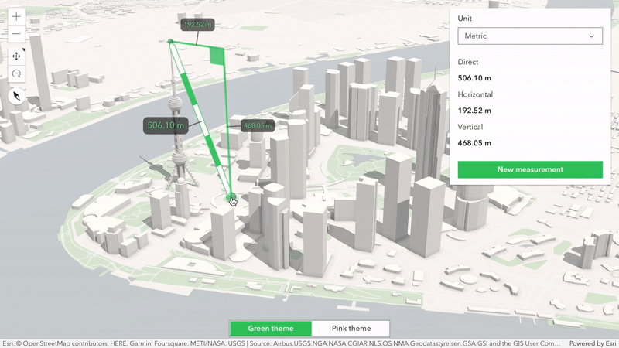
ArcGIS Maps SDK for JavaScript
Advanced GIS Capabilities
Integrated with Esri Services
Robust Data Visualization
Notes:
Supports complex geospatial analytics, 3D visualizations, and real-time data handling.
Seamless connection to ArcGIS for access to basemaps, geocoding, and more.
Handles large datasets with dynamic symbology and rendering, including heatmaps and vector tiles.

Slide 23
How does the ArcGIS Maps SDK for JS Compare to Leaflet/Esri Leaflet?
Feature | ArcGIS Maps SDK for JS | Leaflet/Esri Leaflet
Complexity | More features and capabilities | Simpler, lightweight setup
Data Handling | Efficient with large datasets | Best for smaller datasets
3D & Real-Time | Extensive 3D and real-time support | Limited to basic capabilities
Graphics Rendering | Uses WebGL for complex visuals | Primarily uses DOM rendering

Slide 24
Complete Modules 4 and 5 on the
Workshop Site
Finished early? Explore the d3.js site or revisit any of the demos/modules!

Slide 25
Conclusions
Key Techniques: Explored D3.js, Chart.js, Leaflet, Esri Leaflet, and ArcGIS for dynamic visual storytelling.
Workshop Goals: Improved skills in creating interactive and engaging visualizations.
Next Steps:
Apply skills to new projects.
Share work on platforms like GitHub.
Join and participate in related online communities.

Slide 26
Resources
Chart.js Github Repo
Chart.js Github Awesome list - curated list of Chart.js resources and libraries
Chart.js Site
D3.js Github Repo
D3.js Site
Leaflet Site
ArcGIS Maps SDK for JavaScript Documentation

